Slide 1
Support Vector Machines
Andrew W. Moore
Professor
School of Computer Science
Carnegie Mellon University
www.cs.cmu.edu/~awm
awm@cs.cmu.edu
412-268-7599
Note to other teachers and users of these slides. Andrew would be delighted if you found this source material useful in giving your own lectures. Feel free to use these slides verbatim, or to modify them to fit your own needs. PowerPoint originals are available. If you make use of a significant portion of these slides in your own lecture, please include this message, or the following link to the source repository of Andrew’s tutorials: http://www.cs.cmu.edu/~awm/tutorials . Comments and corrections gratefully received.
Slides Modified
Copyright © 2001, 2003, Andrew W. Moore
Nov 23rd, 2001

Slide 2

History
SVM is a classifier derived from statistical learning theory by Vapnik and Chervonenkis
SVMs introduced by Boser, Guyon, Vapnik in COLT-92
Initially popularized in the NIPS community, now an important and active field of all Machine Learning research.
Special issues of Machine Learning Journal, and Journal of Machine Learning Research.
Copyright © 2001, 2003, Andrew W. Moore

Slide 3
Linear Classifiers
α
x
f
y^{est}
f(x,w,b) = sign(w. x - b)
denotes +1
denotes -1
How would you classify this data?
Copyright © 2001, 2003, Andrew W. Moore

Slide 4
Linear Classifiers
α
x
f
y^{est}
f(x,w,b) = sign(w. x - b)
denotes +1
denotes -1
How would you classify this data?
Copyright © 2001, 2003, Andrew W. Moore

Slide 5
Linear Classifiers
α
x
f
y^{est}
f(x,w,b) = sign(w. x - b)
denotes +1
denotes -1
How would you classify this data?
Copyright © 2001, 2003, Andrew W. Moore

Slide 6
Linear Classifiers
α
x
f
y^{est}
f(x,w,b) = sign(w. x - b)
denotes +1
denotes -1
How would you classify this data?
Copyright © 2001, 2003, Andrew W. Moore

Slide 7
Linear Classifiers
α
x
f
y^{est}
f(x,w,b) = sign(w. x - b)
denotes +1
denotes -1
Any of these would be fine..
..but which is best?
Copyright © 2001, 2003, Andrew W. Moore

Slide 8
Classifier Margin
α
x
f
y^{est}
f(x,w,b) = sign(w. x - b)
denotes +1
denotes -1
Define the margin of a linear classifier as the width that the boundary could be increased by before hitting a datapoint.
Copyright © 2001, 2003, Andrew W. Moore

Slide 9
Maximum Margin
α
x
f
y^{est}
f(x,w,b) = sign(w. x - b)
denotes +1
denotes -1
The maximum margin linear classifier is the linear classifier with the, um, maximum margin.
This is the simplest kind of SVM (Called an LSVM)
Linear SVM
Copyright © 2001, 2003, Andrew W. Moore

Slide 10
Maximum Margin
α
x
f
y^{est}
f(x,w,b) = sign(w. x - b)
denotes +1
denotes -1
The maximum margin linear classifier is the linear classifier with the, um, maximum margin.
This is the simplest kind of SVM (Called an LSVM)
Support Vectors are those datapoints that the margin pushes up against
Linear SVM
Copyright © 2001, 2003, Andrew W. Moore

Slide 11
Why Maximum Margin?
Intuitively this feels safest.
Empirically it works very well.
If we’ve made a small error in the location of the boundary (it’s been jolted in its perpendicular direction) this gives us least chance of causing a misclassification.
Model is immune to removal of any non-support-vector datapoints.
f(x,w,b) = sign(w. x - b)
denotes +1
denotes -1
The maximum margin linear classifier is the linear classifier with the, um, maximum margin.
This is the simplest kind of SVM (Called an LSVM)
Support Vectors are those datapoints that the margin pushes up against
Copyright © 2001, 2003, Andrew W. Moore

Slide 12
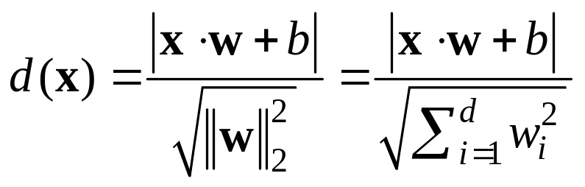
Estimate the Margin
denotes +1
denotes -1
wx +b = 0
x
X – Vector
W – Normal Vector
b – Scale Value
W
What is the distance expression for a point x₁ to a line wx+b= 0?
1
1
1
Copyright © 2001, 2003, Andrew W. Moore

Slide 13
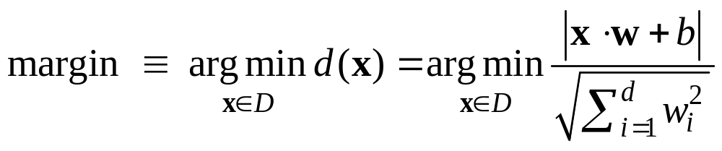
Estimate the Margin
denotes +1
denotes -1
wx +b = 0
Margin
What is the expression for margin?
Copyright © 2001, 2003, Andrew W. Moore

Slide 14
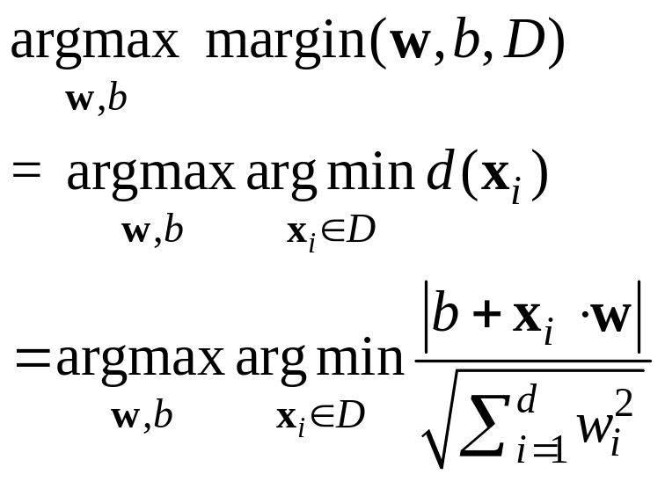
Maximize Margin
denotes +1
denotes -1
wx +b = 0
Margin
Copyright © 2001, 2003, Andrew W. Moore

Slide 15
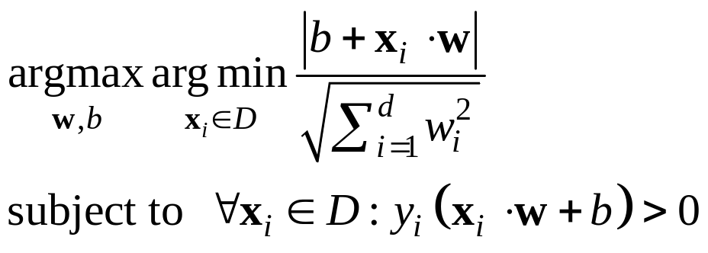
Maximize Margin
denotes +1
denotes -1
wx +b = 0
WX_{i}+b≥0 iff y_{i}=1
WX_{i}+b≤0 iff y_{i}=-1
Margin
yi(WX_{i}+b) ≥0
≥0
Min-max problem → game problem
Copyright © 2001, 2003, Andrew W. Moore

Slide 16
Uh-oh!
This is going to be a problem!
What should we do?
denotes +1
denotes -1
Copyright © 2001, 2003, Andrew W. Moore

Slide 17
Uh-oh!
This is going to be a problem!
What should we do?
Idea 1:
  Find minimum w.w, while minimizing number of training set errors.
    Problemette: Two things to minimize makes for an ill-defined optimization
denotes +1
denotes -1
Copyright © 2001, 2003, Andrew W. Moore

Slide 18
Uh-oh!
This is going to be a problem!
What should we do?
Idea 1.1:
  Minimize
  w.w + C (#train errors)
denotes +1
denotes -1
Tradeoff parameter
Copyright © 2001, 2003, Andrew W. Moore

Slide 19
Uh-oh!
This is going to be a problem!
What should we do?
Idea 1.1:
  Minimize
  w.w + C (#train errors)
There’s a serious practical problem that’s about to make us reject this approach. Can you guess what it is?
denotes +1
denotes -1
Tradeoff parameter
Can’t be expressed as a Quadratic Programming problem.
Solving it may be too slow.
(Also, doesn’t distinguish between disastrous errors and near misses)
So… any other ideas?
Copyright © 2001, 2003, Andrew W. Moore

Slide 20
Uh-oh!
This is going to be a problem!
What should we do?
Idea 2.0:
  Minimize
  w.w + C (distance of error
  points to their
  correct place)
denotes +1
denotes -1
Copyright © 2001, 2003, Andrew W. Moore

Slide 21
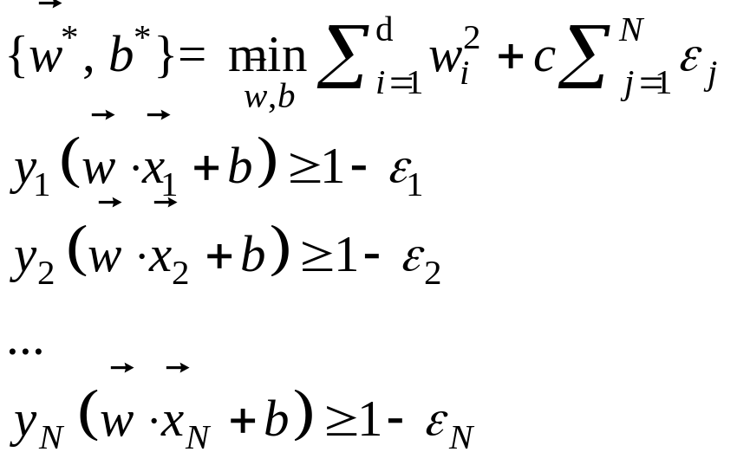



Support Vector Machine (SVM) for Noisy Data
denotes +1
denotes -1
Any problem with the above formulism?
Copyright © 2001, 2003, Andrew W. Moore

Slide 22
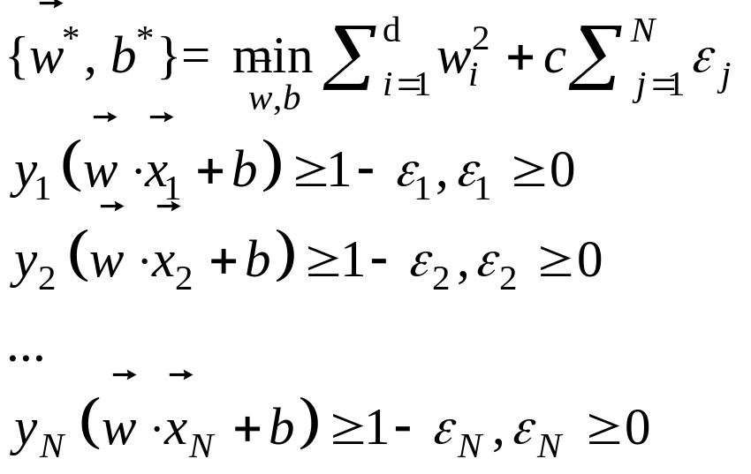
Support Vector Machine (SVM) for Noisy Data
denotes +1
denotes -1
Balance the trade off between margin and classification errors
Copyright © 2001, 2003, Andrew W. Moore

Slide 23
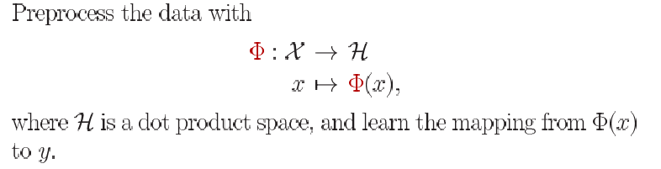

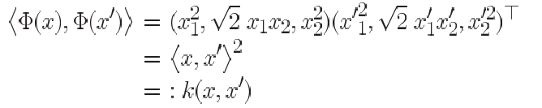
Efficiency Problem in Computing Feature
Feature space Mapping
This use of kernel function to avoid carrying out Φ(x) explicitly is known as the kernel trick
Example: all 2 degree Monomials
9 Multipllication
kernel trick
3 Multipllication
Copyright © 2001, 2003, Andrew W. Moore

Slide 24
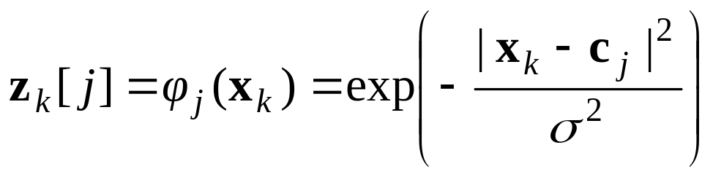
Common SVM basis functions
z_{k} = ( polynomial terms of x_{k} of degree 1 to q )
z_{k} = ( radial basis functions of x_{k} )
z_{k} = ( sigmoid functions of x_{k} )
Copyright © 2001, 2003, Andrew W. Moore

Slide 25
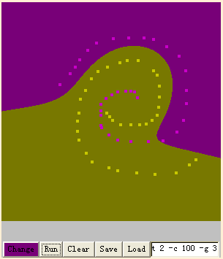

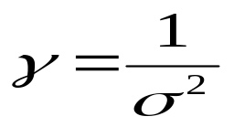
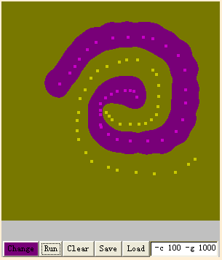
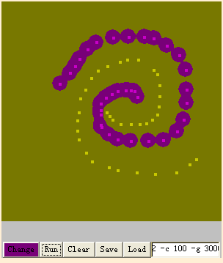
Online Demo
“Radius Basis Function” (Gaussian Kernel) Could solve complicated Non-Linear Problems
γ and c control the complexity of decision boundary
Copyright © 2001, 2003, Andrew W. Moore

Slide 26


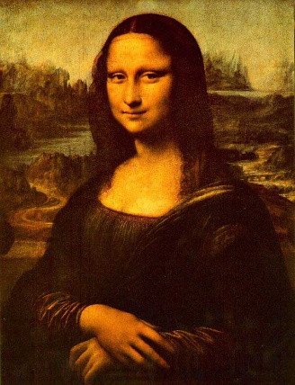


How to Control the Complexity
Which reasoning below is the most probable?
Bob got up and found that breakfast was ready
  Level-1 His Child (Underfitting)
  Level-2 His Wife (Reasonble) ☺
  Level-3 The Alien (Overfitting)
Copyright © 2001, 2003, Andrew W. Moore

Slide 27
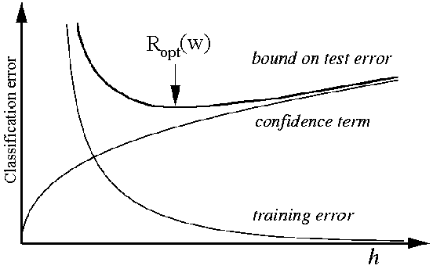
How to Control the Complexity
SVM is powerful to approximate any training data
The complexity affects the performance on new data
SVM supports parameters for controlling the complexity
SVM does not tell you how to set these parameters
Determine the Parameters by Cross-Validation
Underfitting
Overfitting
complexity
Copyright © 2001, 2003, Andrew W. Moore

Slide 28
Support Vector Machine (SVM) for Noisy Data
denotes +1
denotes -1
Balance the trade off between margin and classification errors
Describe the Theory
Describe the Mistake
Copyright © 2001, 2003, Andrew W. Moore

Slide 29
References
An excellent tutorial on VC-dimension and Support Vector Machines:
    C.J.C. Burges. A tutorial on support vector machines for pattern recognition. Data Mining and Knowledge Discovery, 2(2):955-974, 1998. http://citeseer.nj.nec.com/burges98tutorial.html
The VC/SRM/SVM Bible:
    Statistical Learning Theory by Vladimir Vapnik, Wiley-Interscience; 1998
Software: SVM-light, http://svmlight.joachims.org/, LibSVM, http://www.csie.ntu.edu.tw/~cjlin/libsvm/ SMO in Weka
Copyright © 2001, 2003, Andrew W. Moore

Slide 30
Support Vector Regression
Copyright © 2001, 2003, Andrew W. Moore
Nov 23rd, 2001

Slide 31
Roadmap
Squared-Loss Linear Regression
Linear-Loss Function
Support Vector Regression
Copyright © 2001, 2003, Andrew W. Moore

Slide 32
Linear Regression
α
x
f
y^{est}
f(x,w,b) = w. x - b
How would you fit this data?
Copyright © 2001, 2003, Andrew W. Moore

Slide 33
Linear Regression
α
x
f
y^{est}
f(x,w,b) = w. x - b
How would you fit this data?
Copyright © 2001, 2003, Andrew W. Moore

Slide 34
Linear Regression
α
x
f
y^{est}
f(x,w,b) = w. x - b
How would you fit this data?
Copyright © 2001, 2003, Andrew W. Moore

Slide 35
Linear Regression
α
x
f
y^{est}
f(x,w,b) = w. x - b
How would you fit this data?
Copyright © 2001, 2003, Andrew W. Moore

Slide 36
Linear Regression
α
x
f
y^{est}
f(x,w,b) = w. x - b
Any of these would be fine..
..but which is best?
Copyright © 2001, 2003, Andrew W. Moore

Slide 37
Linear Regression
α
x
f
y^{est}
f(x,w,b) = w. x - b
How to define the fitting error of a linear regression ?
Copyright © 2001, 2003, Andrew W. Moore

Slide 38
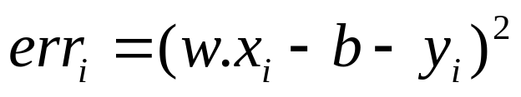
Linear Regression
α
x
f
y^{est}
f(x,w,b) = w. x - b
How to define the fitting error of a linear regression ?
Squared-Loss
Copyright © 2001, 2003, Andrew W. Moore

Slide 39
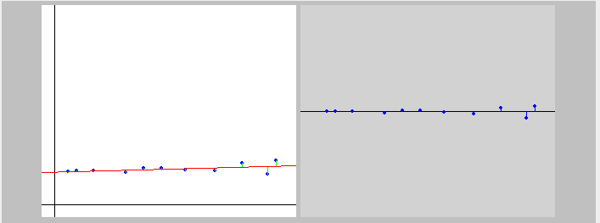
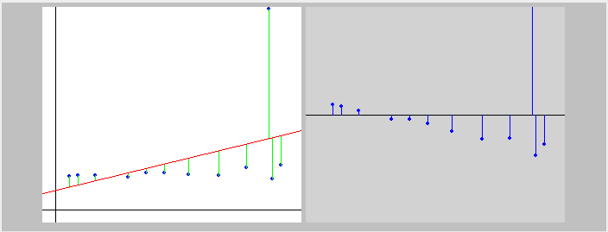
Sensitive to Outliers
Outlier
Copyright © 2001, 2003, Andrew W. Moore

Slide 40
Why ?
Squared-Loss Function
  Fitting Error Grows Quadratically
Copyright © 2001, 2003, Andrew W. Moore

Slide 41
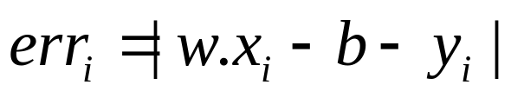
How about Linear-Loss ?
Linear-Loss Function
  Fitting Error Grows Linearly
Copyright © 2001, 2003, Andrew W. Moore

Slide 42
Actually
SVR uses the Loss Function below
ε-insensitive loss function
−ε
ε
Copyright © 2001, 2003, Andrew W. Moore

Slide 43
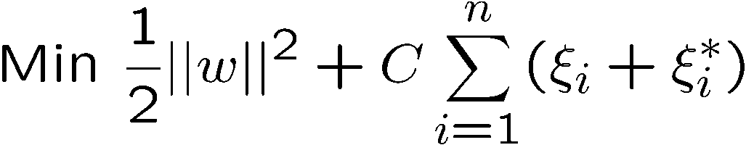
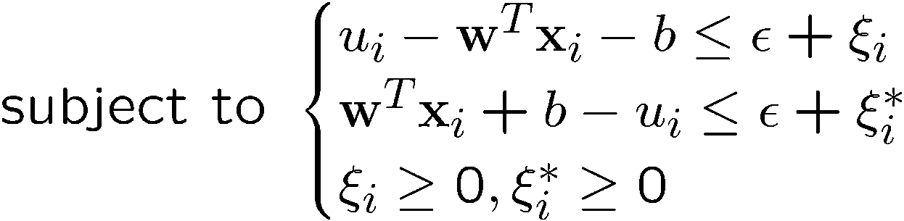
Epsilon Support Vector Regression (ε-SVR)
Given: a data set {x₁, ..., x_{n}} with target values {u₁, ..., u_{n}}, we want to do ε-SVR
The optimization problem is
Similar to SVM, this can be solved as a quadratic programming problem
Copyright © 2001, 2003, Andrew W. Moore

Slide 44
The End
Copyright © 2001, 2003, Andrew W. Moore

